Slide 1
Customer Survey
Proposed Questionnaires (CQR)

Slide 2
Package Form Factor and Packaging
Need early package FF roadmap/changes update - customer capital cost impact
  FF changed significantly in short period, from Purely (2017 PRQ) → Eagle Stream (PRQ EO 2021) → Birch Stream-AP (PRQ EO 2022)
Au pad corrosion – multiple triggers, multiple products, multiple customers, multiple MRBs for ~ 10 years w/o good resolution to closure
  XEON SP is selling from USD 3K – 10K price/unit, can we add few cents per shipping box on seal pack, to stop the moisture from interacting with pad condition that coherent in the assembly process and promotes pad corrosion ? . (note typical FPO size ~0.5 to 1Ku depend on lot yield)
Provide pack/shipping options : e.g. Ship with Thermoform Tray (TFT), JEDEC tray or Tape & Reel (PCH), or CPU w/carrier pre-attached
Fix marking KIZ, content, FOV, location, increase font size – customer unit traceability and inventory mgmt/control

Slide 3
Socket PCBA / Rework
Customer expects 1 SMT recipe to assemble socket for all suppliers and SPC controls.
  Need socket supplier transparency for SMT, equivalent output CTF and shipping tray (e.g. quality control/SPC, # socket/tray, orientation & etc)
  Recent supplier excursion : FIT skt-P4 T0 DP, LOTES skt-P0 sys int failure, FIT skt-P4 Bolster out of spec, FIT skt-V0 lever height and load plate angle issue
RT and HT warpage requirement/control for socket and PCB.
  Customer specially requested Low Temperature Solder and/or Thermal Chip Bonding for and will liquid cooling be POR ?

Slide 4
LM, Socket cover, PnP tool, FTT
Customer expects – automation friendly, easy to install, easy to uninstall (易装，易拆)
FTT – POR for Purely but Non- POR for skt-P4/skt-E and broken PEEK nuts issue
  Strong demand from varies customers due to their dual POR process (automated – 2S and manual – 4S/8S).
  Broken PEEK nuts due to torque driver hitting PEEK nuts and/or torque with angle
FTT/system assembly tool (non-POR support) to address customer concerns – need to include as POR for future platform
Socket cover – customer expects automation friendly and easy to install/ uninstall.

Slide 5
Board/System Functionality Debug and fault isolation

Slide 6
Back Up

Slide 7
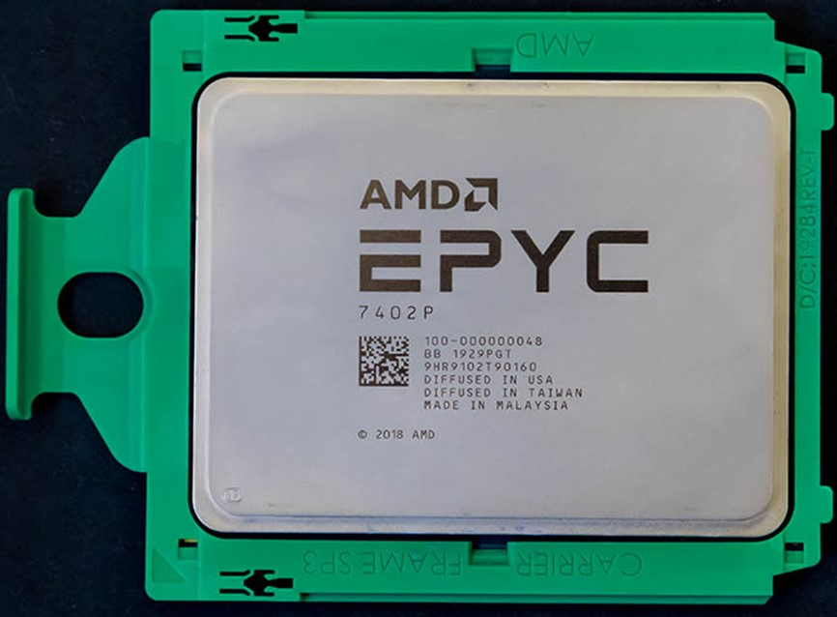
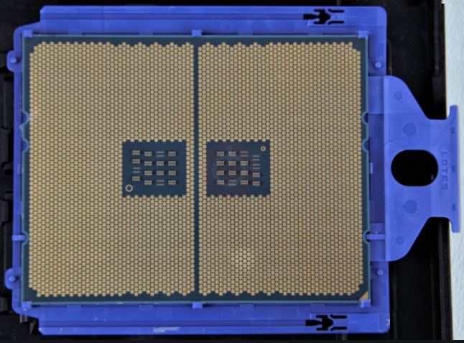

Slide 8
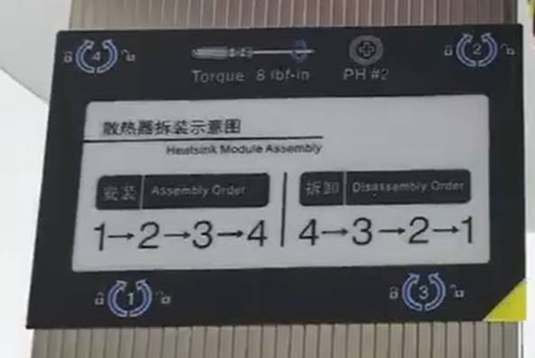
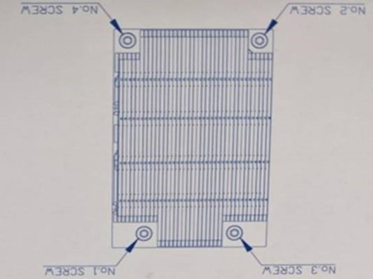
Example : EPYC
Torque 8 IN-LB
Clockwise and anti-clockwise sign for tightening /loosening nuts
Diagonal nuts sequencing
Torque at 8 in-lb
Non symmetrical h/sink nuts layout – fixed orientation
Pin 1 label (triangle sign)

Slide 9
EPYC Processors Series
 | 7001 “Naples” | 7002 “Rome” | 7003 “Milan” | 7004 “Genoa”
Launch | 2017 | 2019 | 2021 | 2022
Architecture | 14nm Zen | 7nm Zen2 | 7nm Zen3 | 5nm Zen4
Socket | SP3 (LGA4094) | SP3 (LGA4094) | SP3 (LGA4094) | SP5 (LGA-6096)
Modules/Chiplets | 4x CCD | 8x CCD + 1x I/0 | 8x CCD + 1x I/O | 12x CCD + 1x I/O
Max Cores | 32C/64T | 64C/128T | 64C/128T | 96C/192T
Max Clock | 3.8 GHz | 3.9 GHz | 4.1 GHz | TBC
Memory Support | 8ch DDR4-2666 ECC | 8ch DDR4-3200 ECC | 8ch DDR4-3200 EEC | 12ch DDR5-5200 ECC
PCIe Lanes | 128x Gen3 | 128x Gen4 | 128x Gen4 | 160x Gen5
Max TDP | 200W | 280W | 280W | 200 – 400W
Rumors of product to be launched with Low Temperature Solder (LTS) PCBA processes
Will LTS happen with liquid cooling ?

Slide 10
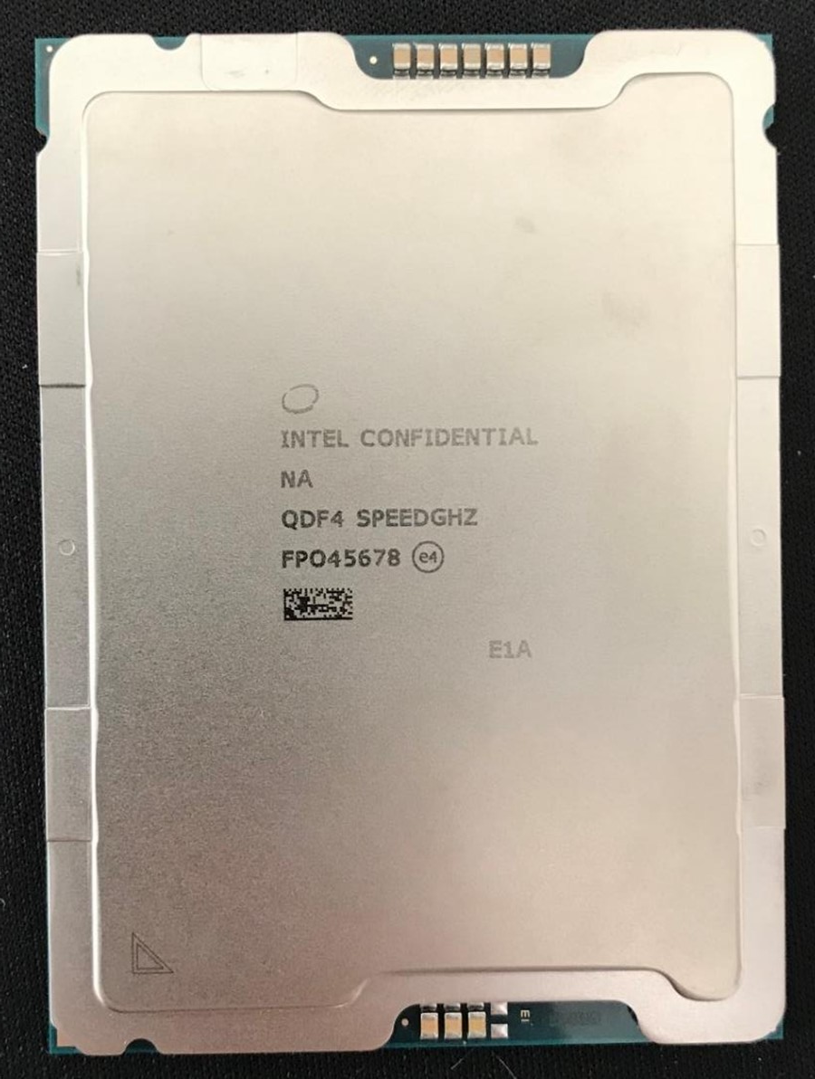
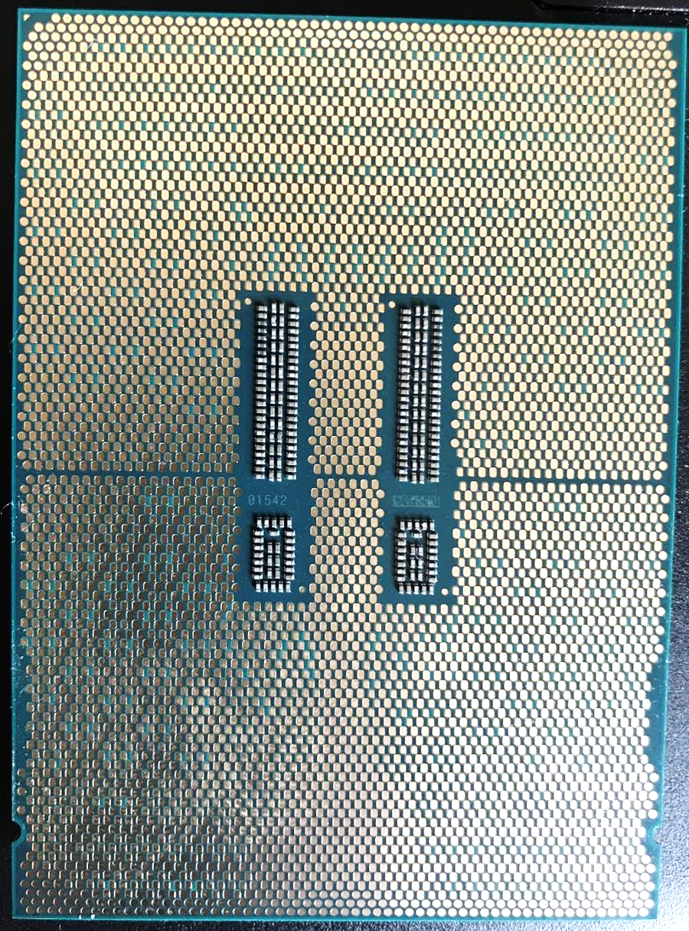
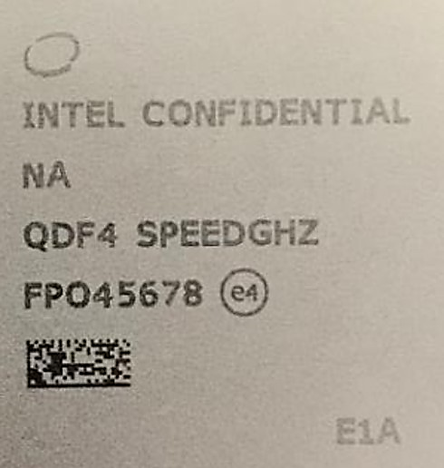
Sapphire Rapids Processor Marking and Identification
Pin 1 Mark
Top side Marking
Line | Marking
GRP1LINE1 (on IHS) | Intel Swirl
GRP1LINE2 (on IHS) | INTEL CONFIDENTIAL {Intel Brand and Brand Modifier}
GRP1LINE3 (on IHS) | N/A {SKU level/Naming}
GRP1LINE4 (on IHS) | QDF4 {SPEC}
GRP1LINE5 (on IHS) | {FPO} {eX}
GRP1LINE6 (on IHS) | 2D Mark {PPIN+SPEC}
GRP1LINE7 (on IHS) | Package Carrier Mark (PCM)
GRP1LINE8 (on IHS) | Pin1 Mark on Lid
2D Mark/ VID (on substrate) | Random number (normally used for FACR)
Pin 1 Mark
PCM
PCM
Bottom side Marking
2DID (2D Matrix) | FPO+ Random number
VID
SN – not good meaning to keep once the FPO human readable is removed
2DID

Slide 11
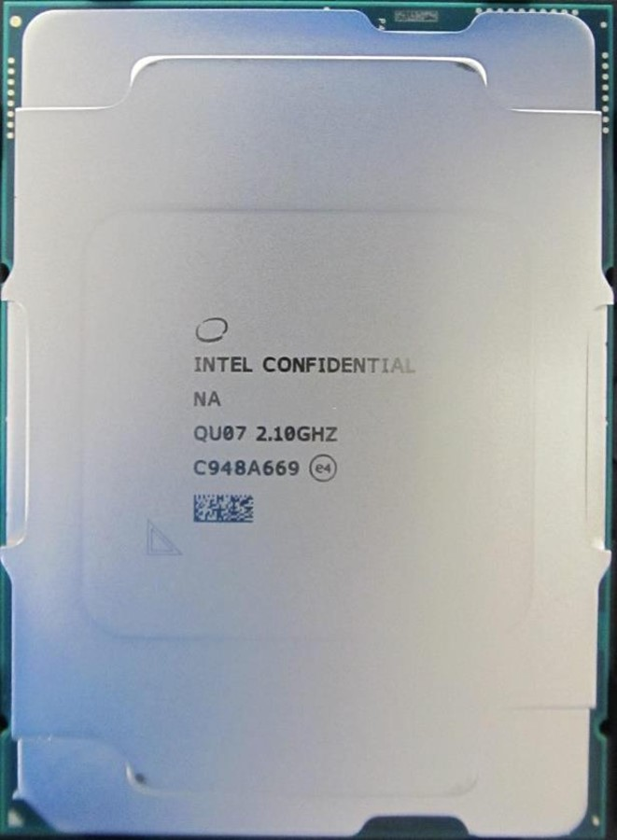
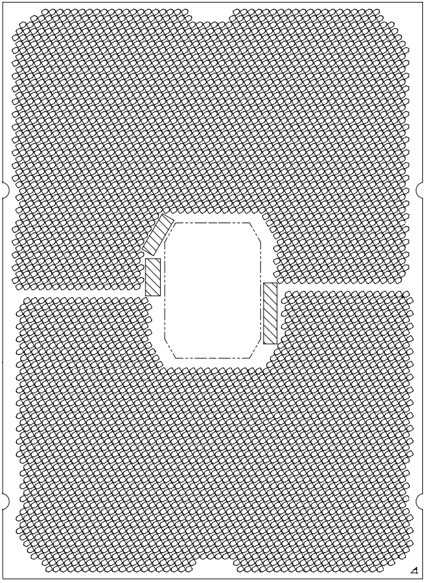
Whitley/Cedar Island Processor (Ice Lake & Cooper Lake)
Example of Marking on Package Top Side
Example of Marking on Package Bottom Side
Top side Marking
Line | Marking
GRP1LINE1 (on IHS) | Intel Swirl
GRP1LINE2 (on IHS) | INTEL CONFIDENTIAL {Intel Brand and Brand Modifier}
GRP1LINE3 (on IHS) | N/A {SKU level/Naming}
GRP1LINE4 (on IHS) | SPEC SPEED
GRP1LINE5 (on IHS) | FPO eX
GRP1LINE6 (on IHS) | 2D Mark {PPIN+SPEC}
GRP1LINE8 (on IHS) | Pin1 Mark on Lid
2D Mark/ VID (on substrate) | Random number (normally used for FACR)
Serial Number
(SN)
2DID
FPO
Bottom side Marking
2DID (2D Matrix) | FPO+ SN (Random number)
Pin 1 Mark

Slide 12
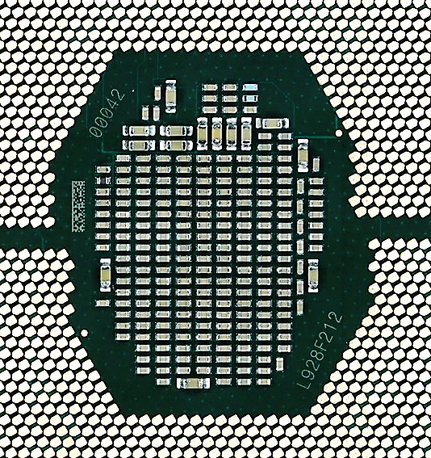
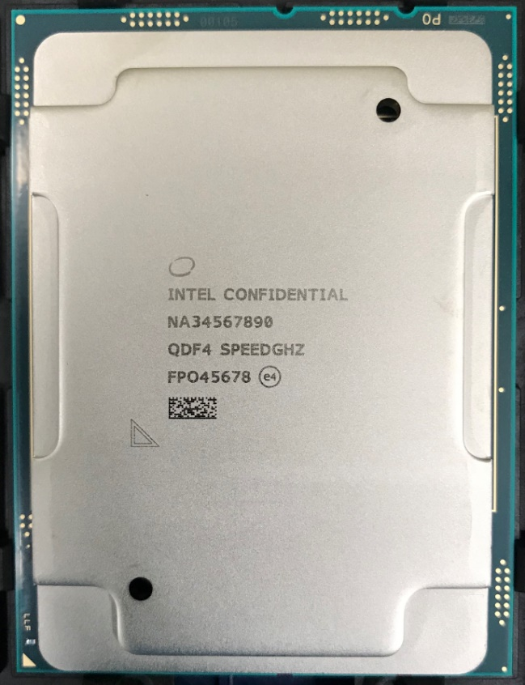
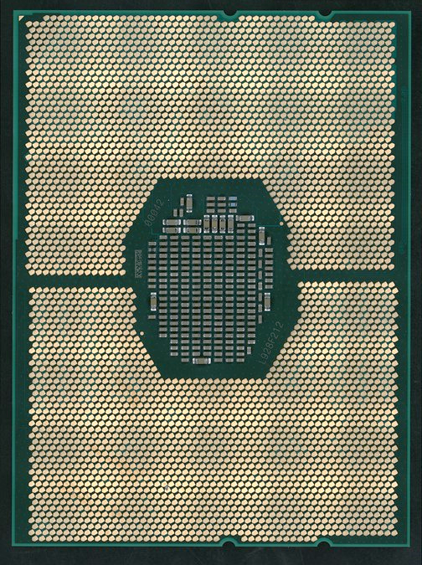
Purley Processor (Cascade Lake)
SN (00042)
Example of Marking on Package Top Side
Example of Marking on Package Bottom Side
Pin 1
Standard 2DID Matrix for traceability (random numbers)
2DID Matrix
FPO + SN
(L928F21200042)
FPO
(L928F212)
(Traceability purpose -- content is different to top side 2DIDs)
2DID Matrix (PPIN + SSPEC)
Dimensions: 2.4mm x5.2mm – alternate traceability
Pin 1
Notes:
Whitley – FPO marking is removed due to limited space.

Slide 13
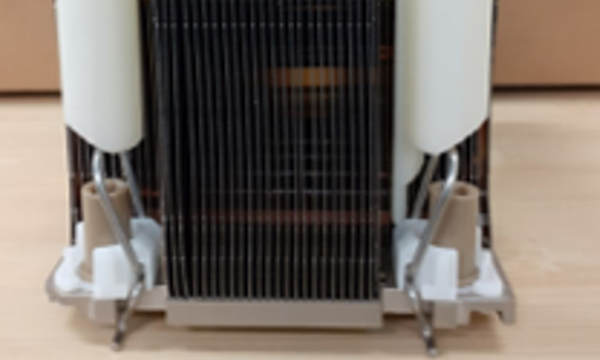
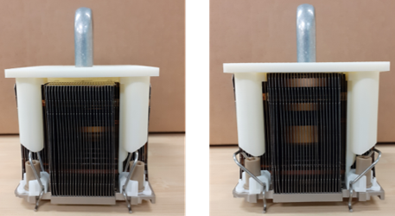
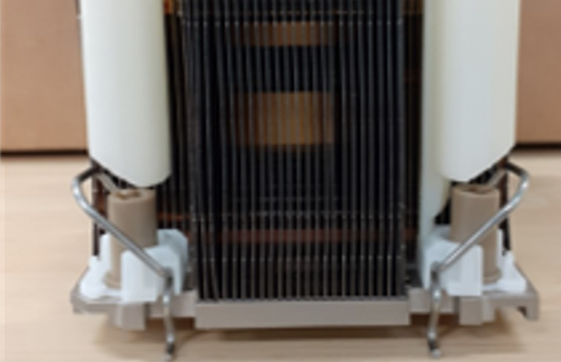
FTT / Sys Assm Tool
(Manual)
1-push to lock anti-tilt wires at 1-time
Provide a guide rail for the torque driver bit, prevent bit hitting PEEK nuts and nuts tightening with angle.
Need nuts sequencing

Slide 14
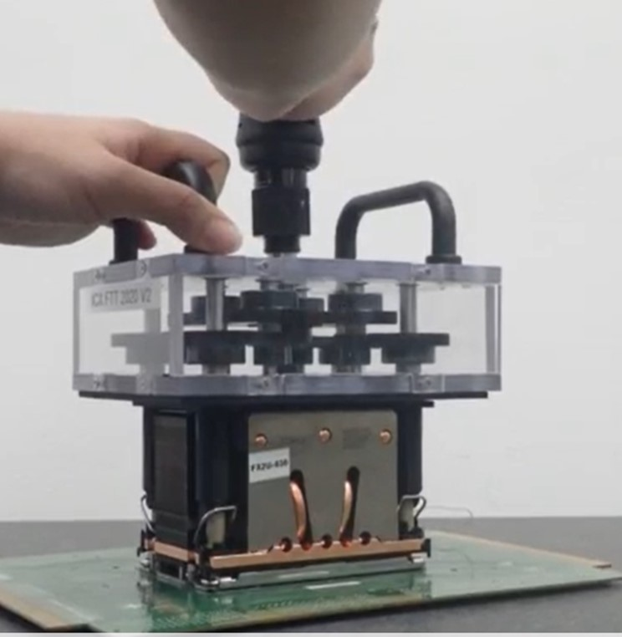
FTT / Sys Assm Tool
(Auto)
1-push to lock anti-tilt wires at 1-time
Provide a guide rail for the torque driver bit, prevent bit hitting PEEK nuts and nuts tightening with angle.
Clutch to driver 4 nuts tighten at single torque.

Slide 15
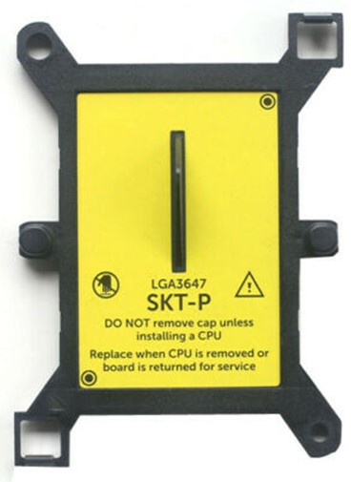
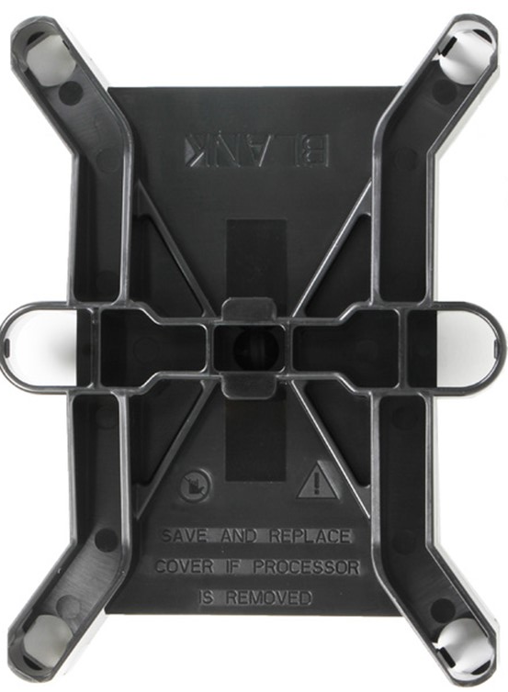
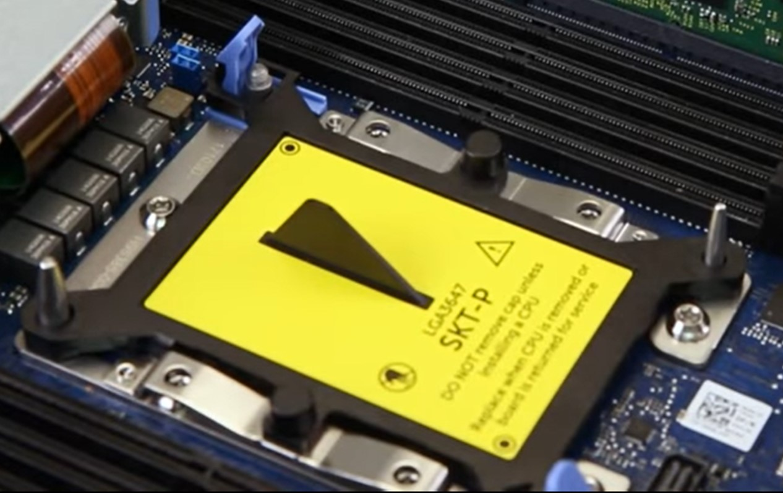
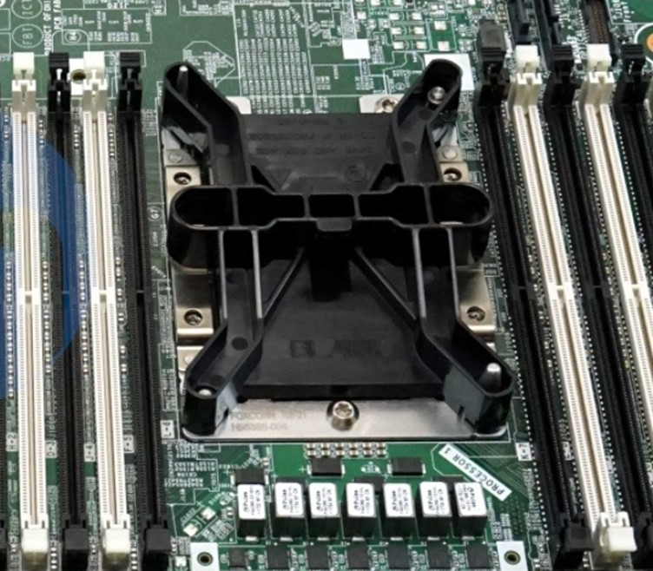
Dust Cover, easy to install, easy to uninstall (易装，易拆 – no ergo spec concerns）
Anti tilt features
DELL socket cover
(Available on eBay, w/additional feature attached on bolster)
HPE socket cover
(FOXCONN)
protection for metal debris ?

Slide 16
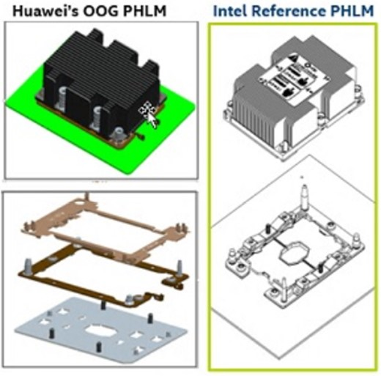
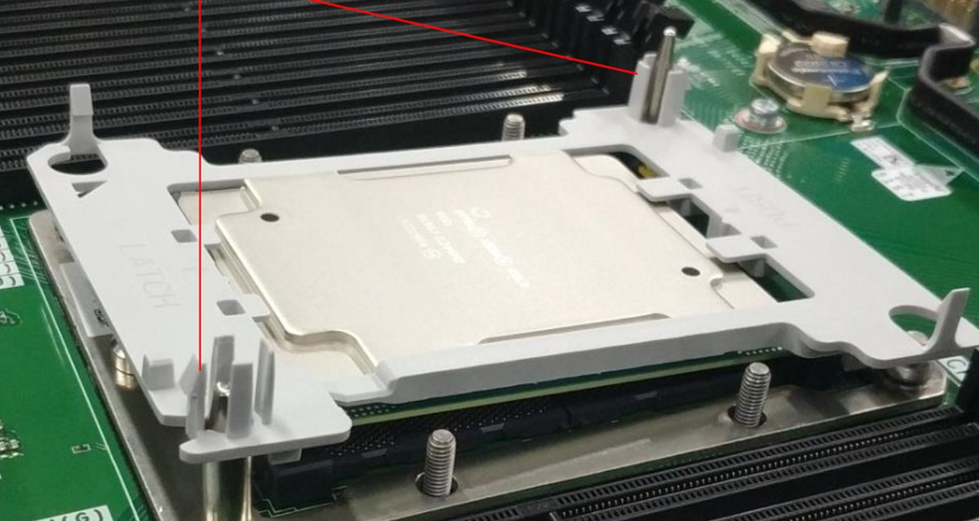
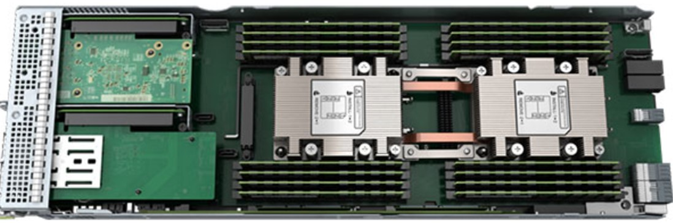
Example: Huawei XH321 V5
(Purley)
Phillips screw driver to tighten all 4 + 2 screws
Customer claimed their PHLM is giving 30% in cost saving
Notes:
https://support.huawei.com/enterprise/en/doc/EDOC1000171910/bdd76eef/installing-a-processor
https://support.huawei.com/enterprise/en/doc/EDOC1000183891/a4cc5fae/installing-a-processor

Slide 17
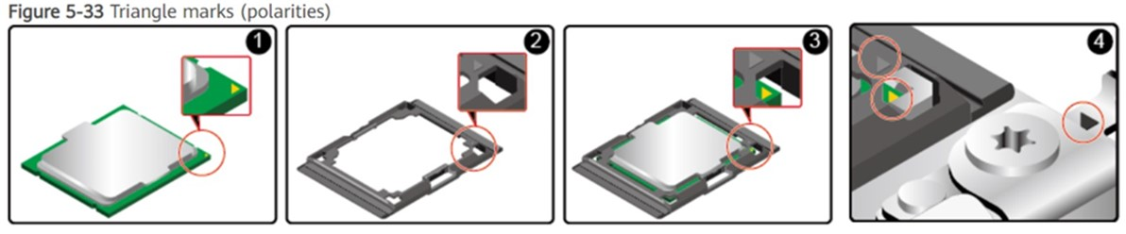
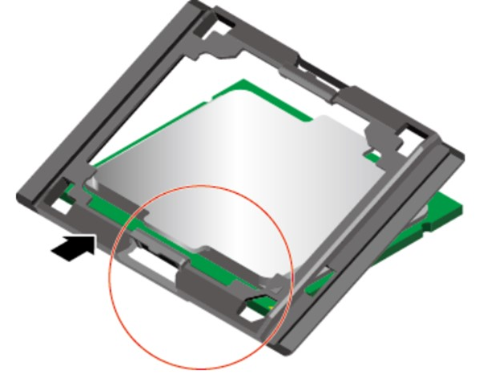
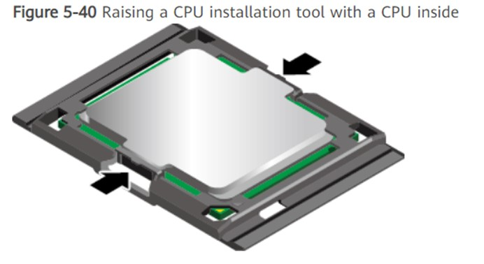
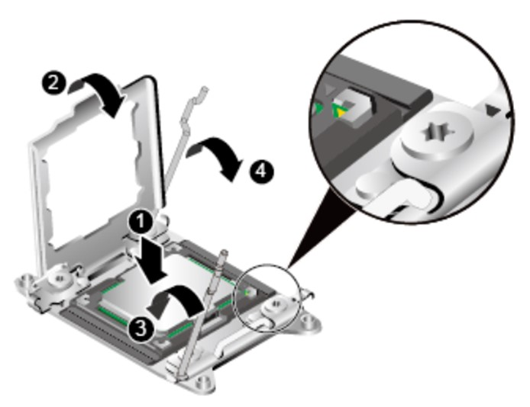
ILM Concept
Notes:
https://support.huawei.com/enterprise/en/doc/EDOC1000078548/89014b24/installing-a-cpu

Slide 18
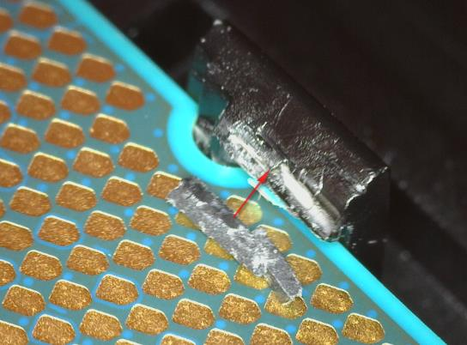
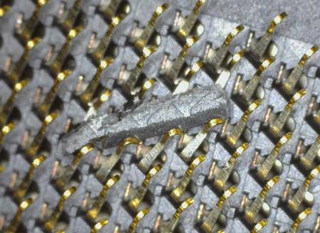

Slide 19
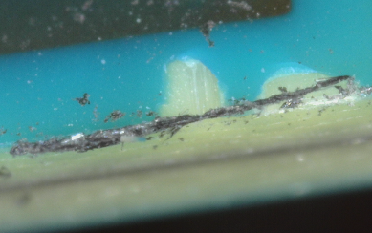
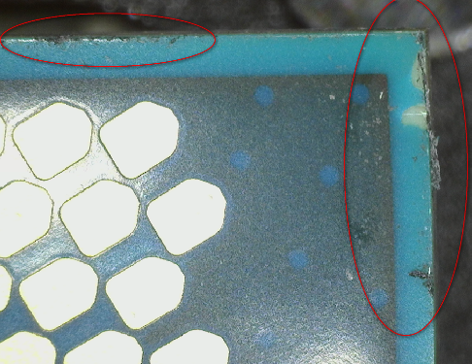
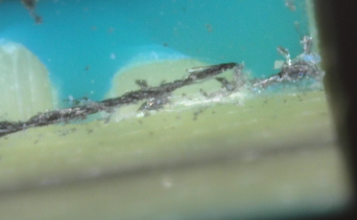

Slide 20
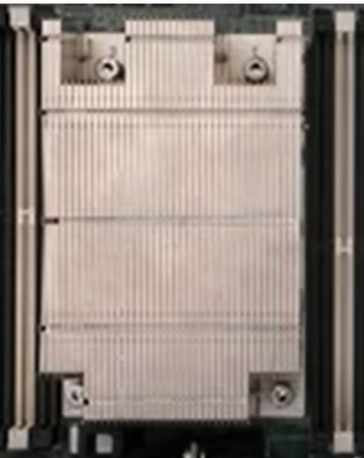
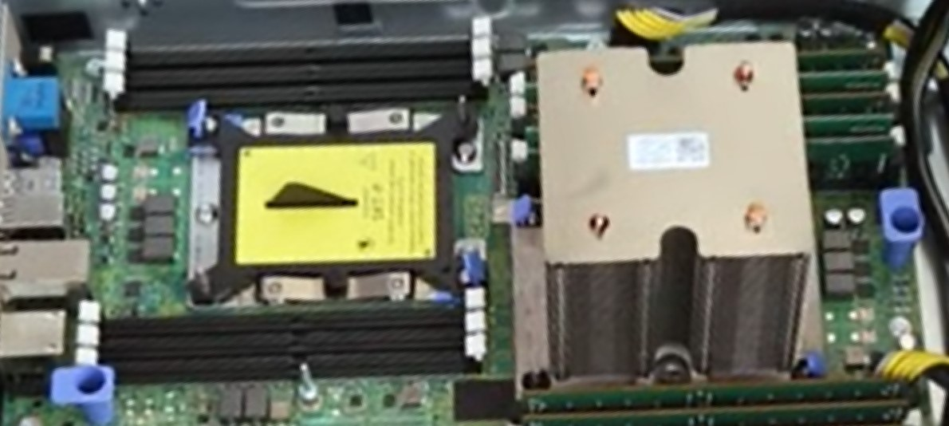
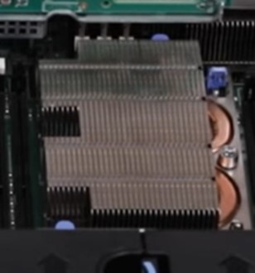
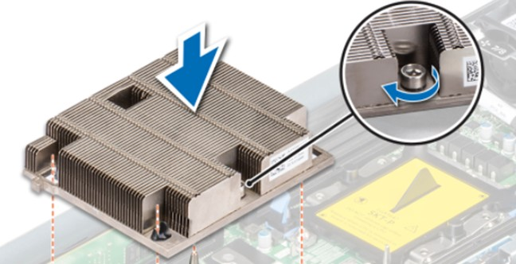
Example (Dell):
Power Edge T440, R740XD2 (Purley)
& R7525 (EPYC SP3)
EPYC
https://www.youtube.com/watch?v=wIx2GSRjIIE
No label on heatsink –
For Purley, probably due to the bolster design only required to tighten 2 nuts.
https://www.dell.com/support/kbdoc/en-sg/000063913/dell-emc-poweredge-t440-how-to-remove-and-install-a-system-board-qrl-video
https://cdn.cnetcontent.com/a1/49/a149014d-d35a-444f-8752-2dc0898e107f.pdf

Slide 21
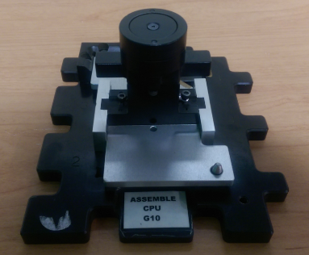
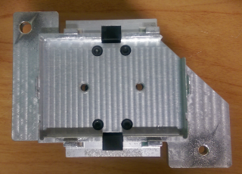
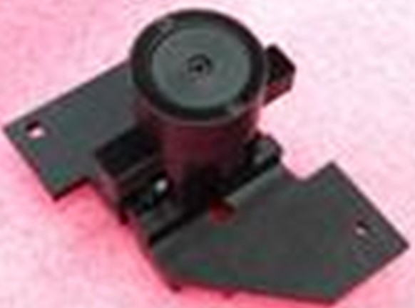
HPE/Inventec CPU PnP Tool

Slide 22
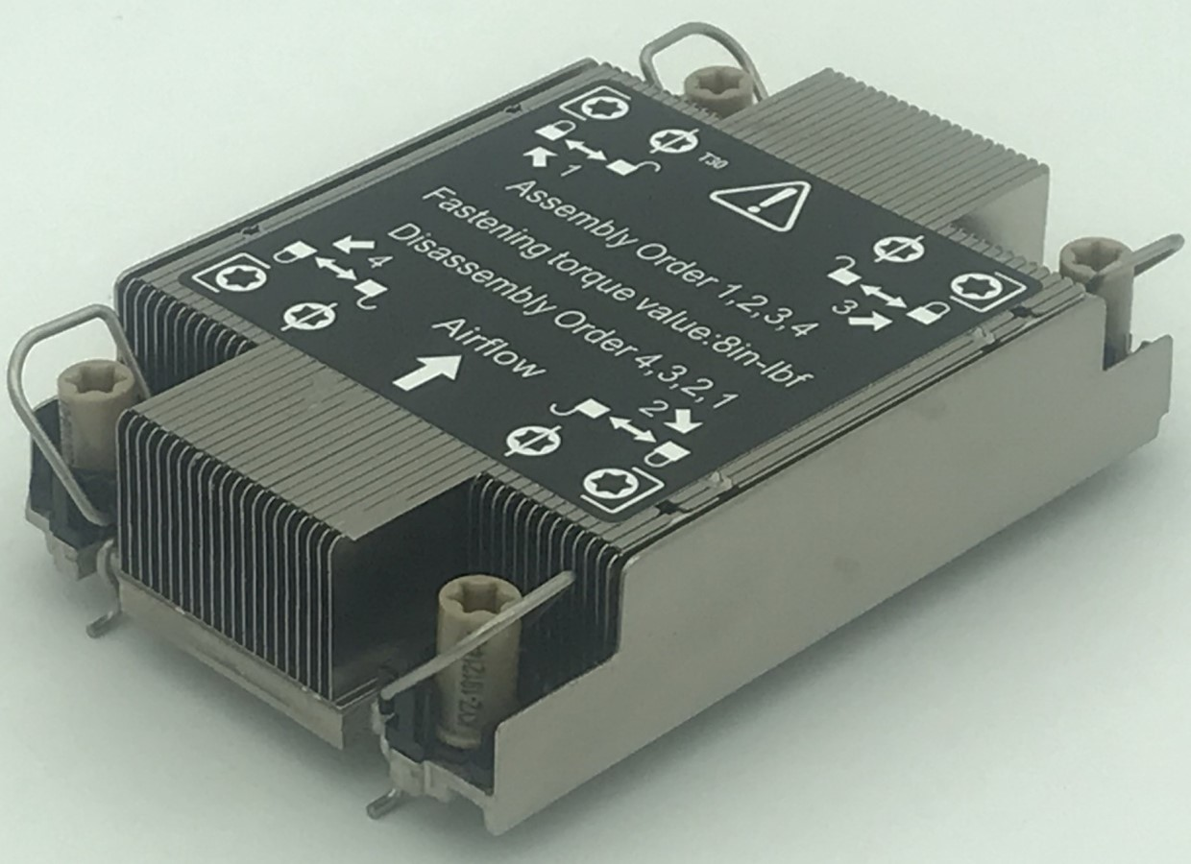
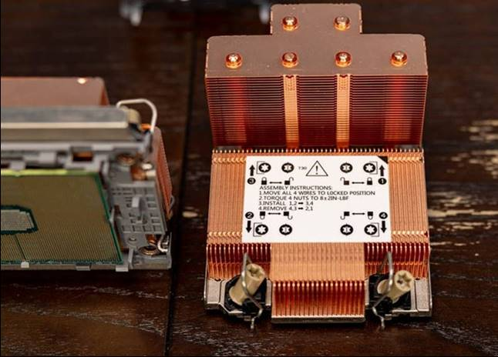
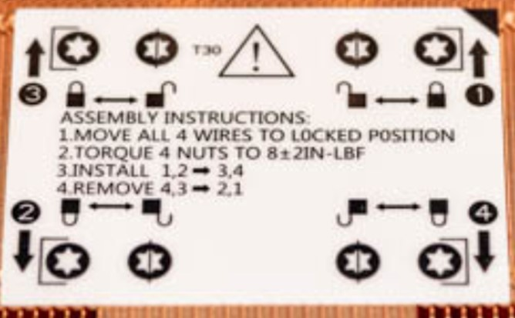
Example :
LGA4189 /Cedar Island
Pin 1 label (triangle sign)
http://www.hojettech.com/pageId34/
Diagonal nuts sequence
https://www.servethehome.com/installing-a-3rd-generation-intel-xeon-scalable-lga4189-cpu-and-cooler/3rd-gen-intel-xeon-scalable-heatsink-top/
https://www.youtube.com/watch?v=GsYUKQyNGwM

Slide 23
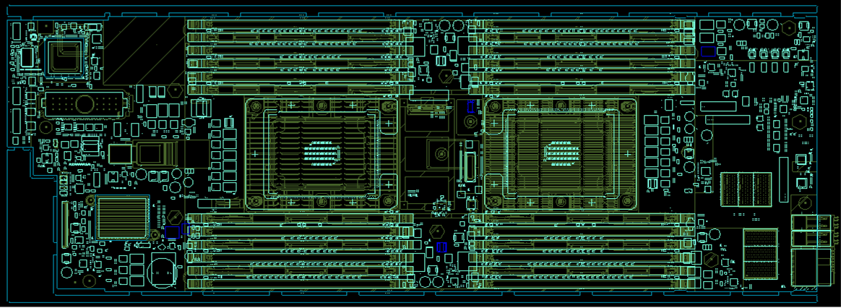
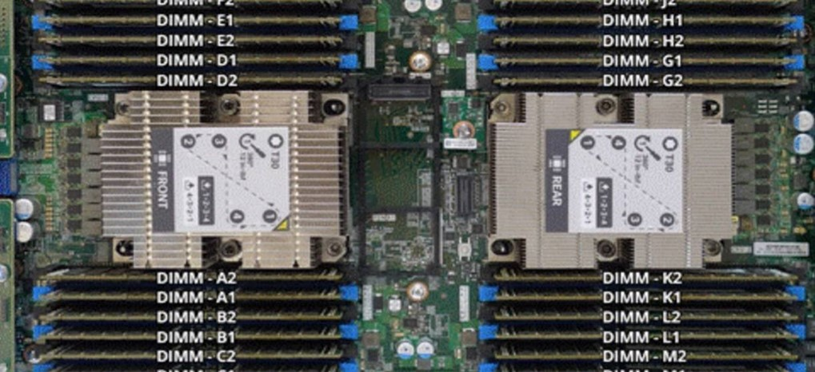
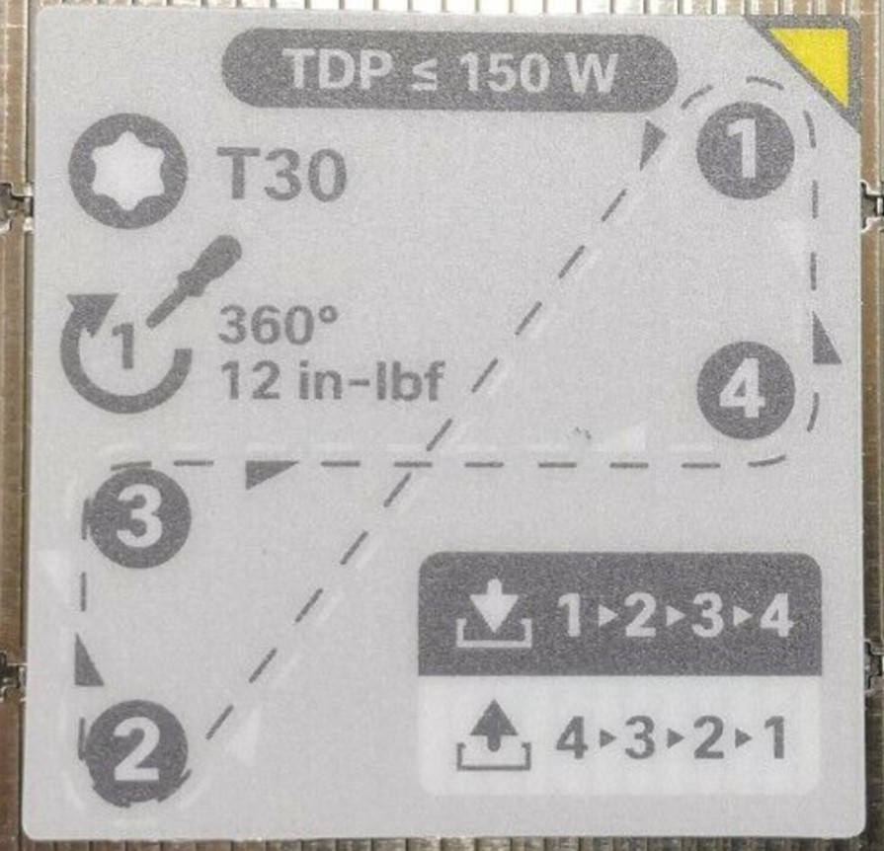
Example (Cisco):
B200M5 (Purely)
Clockwise sign for tightening nuts
2 different labels (FRONT & REAR → orientation)
Using triangle sign as Pin 1 indicator
https://www.cisco.com/c/dam/en/us/products/collateral/servers-unified-computing/ucs-b-series-blade-servers/b200m5-specsheet.pdf
https://www.ebay.com/itm/Cisco-Systems-UCSC-HS-C220M5-Heatsink-/273943848392

Slide 24
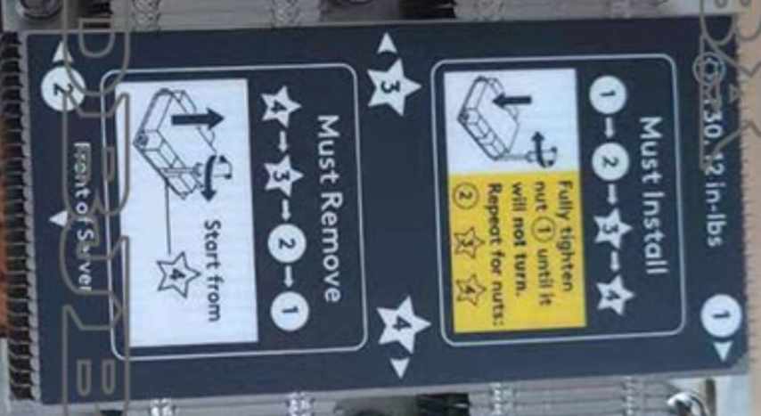
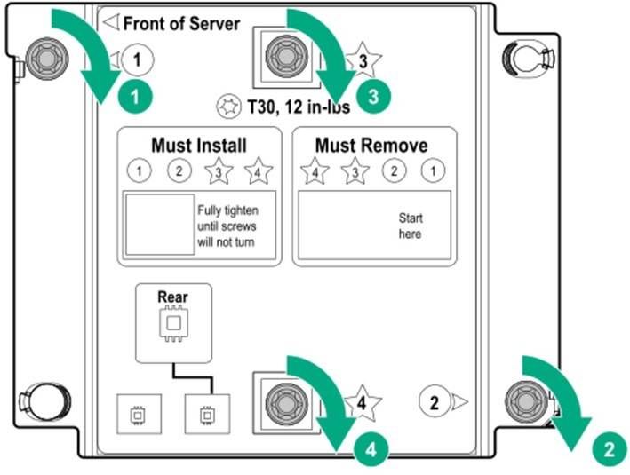
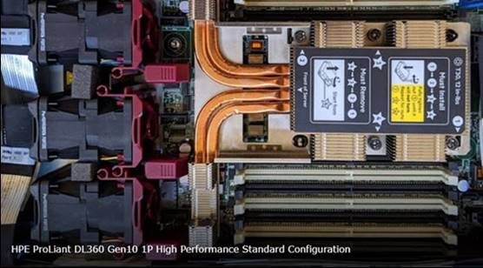
Example (HPE):
DL360, DL580 & Synergy 660 (Purley)
Orientation
https://techlibrary.hpe.com/docs/synergy/660_Gen10/setup_install/GUID-CC673F5D-4456-4C60-883A-F242360251F0.html
https://intelligentservers.co.uk/hpe-dl580-gen10-intel-xeon-gold-6136-3-0ghz-12-core-150w-processor-kit-878135-b21-875724-001

Slide 25
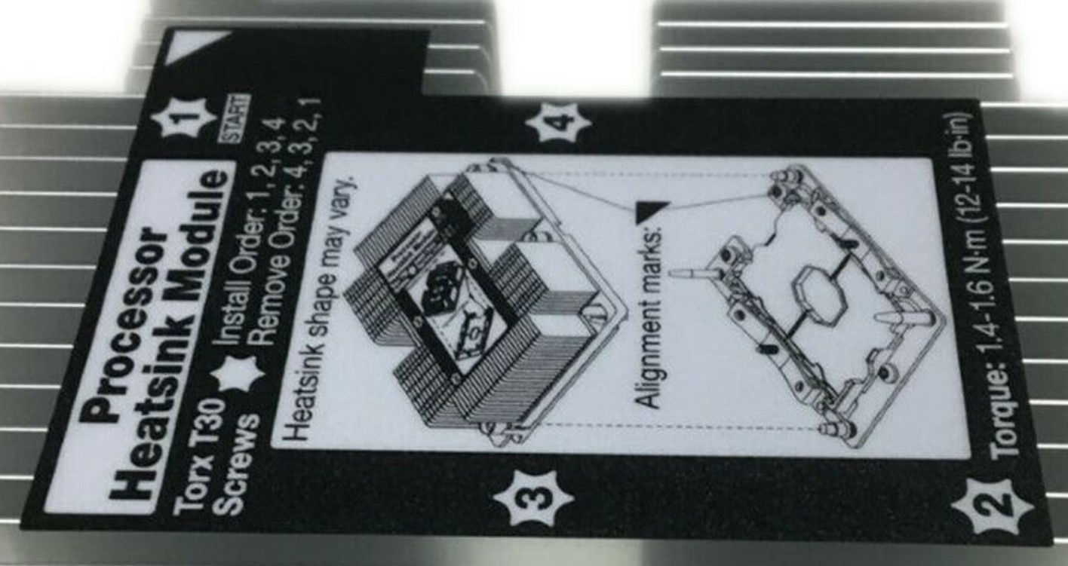
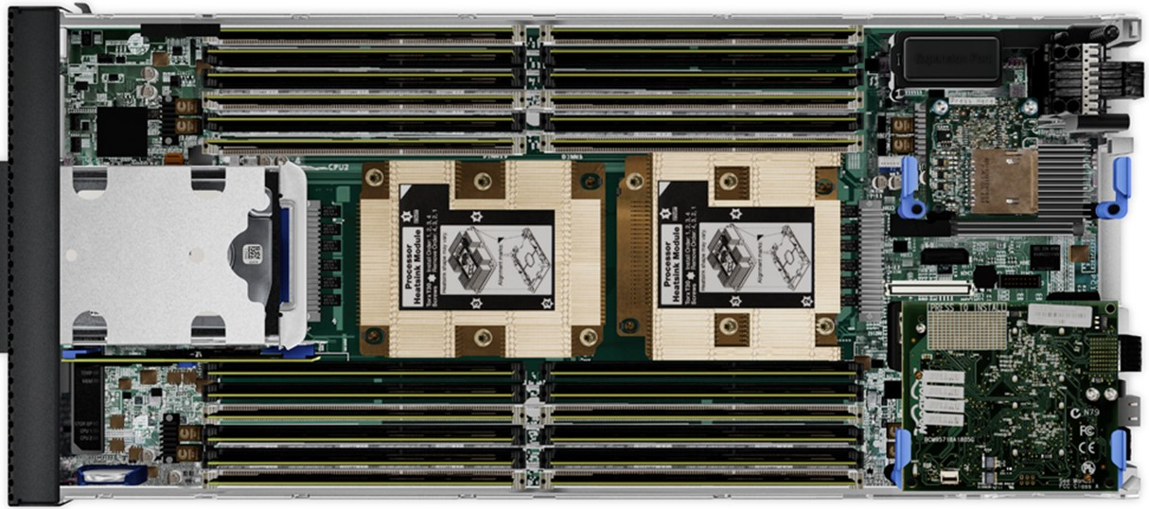
Example (Lenovo):
Thinksystem (Purley)
Using triangle sign as Pin 1 indicator
https://thinksystem.lenovofiles.com/help/index.jsp?topic=%2F7X07%2Fsetup_install_a_microprocessor.html

